Slide 1
Nested Loops & Exit Statement
ELEC1006: ENGINEERING COMPUTING

Slide 2

Combining Loops
Loops can be combined together (nested loops).
The statement within a loop can contain another loop:
int i, j;
for (i = 0; i < 4; i++)
{
for (j = 0; j < 4; j++)
{
// statements
}
}
PAGE 2

Slide 3
Nested Loops
Inner loop goes through all repetitions for each repetition of outer loop
Inner loop repetitions complete sooner than outer loop
Total number of repetitions for inner loop is the product of number of repetitions of the two loops.
PAGE 3

Slide 4
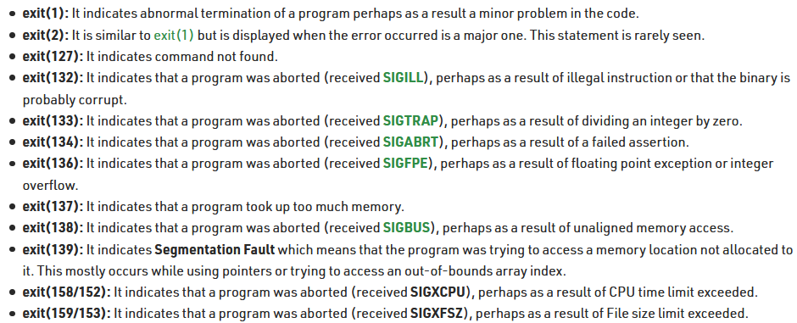
exit() Statement
Use exit(n) to exit the program.
n is a specific exit code:
0 for successful exit.
1 or non-zero number for failure as mentioned below.
PAGE 4

Slide 5
Example
#include <iostream>
using namespace std;
int main ()
{
unsigned long n=1;
for (n; n<5; n++)
{
cout << "hello world\n";
if(n==2)
exit(1);
}
cout << "this is the end of the program.";
return 0;
}
PAGE 5

Slide 6
More info
[1] cplusplus.com: Statements and flow control
https://cplusplus.com/doc/tutorial/control/
[2] cplusplus.com: function exit
https://cplusplus.com/reference/cstdlib/exit/?kw=exit
[3] learncpp.com: 5.7 – For statements
https://www.learncpp.com/cpp-tutorial/57-for- statements/
[4] Exit codes in C/C++ with Examples
https://www.geeksforgeeks.org/exit-codes-in-c-c-with- examples/
PAGE 6

